Slide 1
Annual General Meeting
15 May 2024

Slide 2
Shamley Green Village Hall AGM Agenda 15 May 2024
1. Welcome
2. Apologies for Absence
3. Approval of Minutes of AGM 23 April 2023
4. Chairman’s Report- Jon Watson
5. Treasurer’s Report- Jon Watson
6. Appointment of Elected Members (Trustees) to the Management Committees- Paulina Bayliss
7. Appointment of Representative Members (Trustees) to the Management Committee- Paulina Bayliss
8. Appointment of Co-opted Members (Trustees) to the Management Committee- Paulina Bayliss

Slide 3
Shamley Green Village Hall AGM Agenda 15 May 2024
9. Motion to change the Constitution – Paulina Bayliss
10. The Hall Development Report – Jon Watson
11. Events and Marketing Report – Lyn Barber
12. Fundraising Report – Jim Drummond
13. Hall Operations – Jon Watson
14. Governance Report – Fiona Cameron
15. A.O.B. Questions Close

Slide 4
Minutes of AGM held on 23 April 2023
Copies are circulated around the room
Matters Arising
Approval of the Minutes Proposed and Seconded

Slide 5
Chair’s Report
Progress
Finances are satisfactory
Expand the use of the Hall as a Community Hub

Slide 6
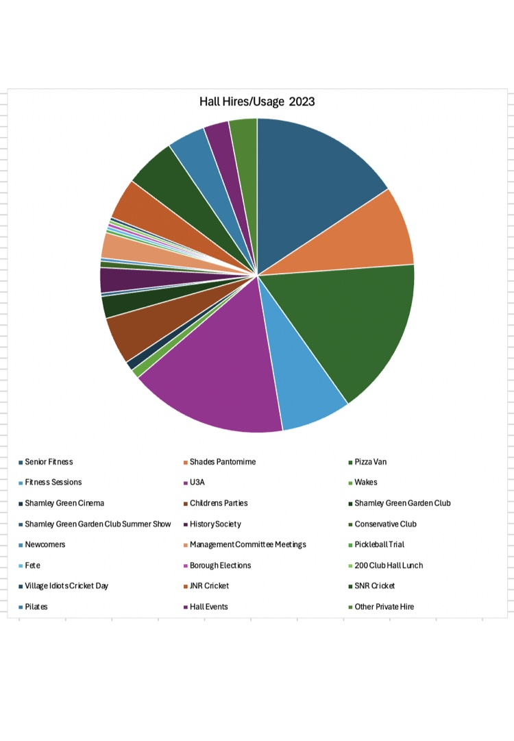
Chair’s Report

Slide 7
Chair’s Report cont.
cont’d
Hall Managed Events and Marketing
Property Development
Fundraising
Governance
Looking at Changes in Governance
Management Committee
Growth Time and Resources
Thank You

Slide 8
Treasurer’s Report
The Financial Accounts for the Shamley Green Village Hall known as Arbuthnot Hall for the 12 month period 1st March 2023 to 29 February 2024 have been circulated around the room.
Operating Income and Expenses
Total operating income increased to £23,852 from £23,343, within which hire charges increased to £9,305 and hall own events income increased to £13,778
Total operating expenses reduced to £17,924 from £26,532
Net operating surplus £5,924

Slide 9
Treasurer’s Report cont.
Donations and Property Development
We raised £48k in Donations plus £5k Gift Aid, whilst spent £14k on Property Development Project
Consolidated Result
Total income reached £78k, less expenses expenditure of £32k resulting in a total surplus for the period of £46k.
Balance Sheet dominated by £85k Cash held of which £34k held for Property Development
Independent Examiner
Richard Holmes FCA has conducted an Independent Review of these accounts in accordance with the Charities Act 2011 and given a clean bill of health.
Proposer and seconder for the approval of these accounts.

Slide 10
Appointment Elected Members
Paulina Bayliss Nominated Penny Hodgson and Lynda Rice
Fiona Cameron Nominated Lucy Camsey and Jon Watson
Lucy Camsey Nominated Raymonde Jay and Annabelle Ball
Jonathan Watson Nominated Gary Wicks and Helena Watson
Michael Band Nominated John Page and Athar Shareef

Slide 11
Appointment Representative Members
Jim Drummond- Shamley Green Cricket Club
Lindsey Slater- SGVA
Tim Harlow- Fete Committee
Chris Howard- Wonersh Parish Council

Slide 12
Appointment Co Opted Members
Gillian Morris
Alastair Hilton

Slide 13
Motion to Change Constitution
With regard to the Constitution of Shamley Green Village Hall known as Arbuthnot Hall, Charity No 305149 dated 5th May 1966 as amended 19th October 1989 it is proposed that the following resolution be passed .
Clause 3 Delete existing clause of the Deed Dated 5th May 1966 Cash -sums of Cash at any time belonging to the charity and not needed for immediate working purposes shall be invested in the name of the said Official Custodian unless the Charity Commissioners otherwise direct. Insert new clause Cash- sums of Cash at any time belonging to the Charity shall be deposited in the name of the Charity with CAF Bank Limited and or any other UK Authorised Bank and or in the name of the said Official Custodian unless Charity Commissioners otherwise direct.

Slide 14
Hall Development Plans
Presented by Jon Watson

Slide 15
Hall Development Plans
Year to Date:
At the AGM 23RD April 2023, we put forward a procurement timeline, in the knowledge that there will need to be some flexibility in this. So, where we are, a year on, is as follows:
Phase 1 – Initial Concept Planning - completed.
Phase 2 – First Village Consultation 13th November 2022 – First design concepts introduced.
Phase 3 – Appointment of Architects, following issue of RFPs to three Practices and post submission interviews.
Lytle Associates appointed in July 2023, with a RIBA Contract subsequently signed.
Phase 4 – Q4 2023. Commencement of detailed design work and appointment of the additional consultants required for the pre planning work. Three quotes per consultant, were obtained. Those appointed with their fixed costs are set out below. Expenditure to date is £33,987.

Slide 16
Hall Development Plans
RIBA Stages 1-3 (Planning) - Fees
Action/Reason for Cost | Consultant | Fee
Floor Plans/Measured Survey | Katsura | £2,795 | No Vat
Ecology Report | Sylvatica | £1,822
Arboriculturists | Green Earth | £350
Heritage Consultant | Sarah Sullivan | TBC
Highway Consultant | RGP | £1,950
Energy Assessor | Mesh Energy | £1,488
Asbestos Consultant | JETO | £360
QS | MEA | £2,250
Acoustic Consultant | Spratt and Hammer | £1,660
Planning Fee | Waverley | £988
Architects Fees | Lytle Associates | £17,500
Report on Title | Stan Baring | £250
 |  | £31,413 | Subtotal
Contingency | N/A | £3,141 | 10.00%
 |  | £40,907 | Plus VAT

Slide 17
Hall Development Plans
Phase 5 – 2nd Village Consultation 29th February 2024 – Finalised drawings/plans that will go forward for Planning, presented to the Village. These are available to view on the Arbuthnot Hall website as below.
https://www.arbuthnothall.org/
Phase 6 – Planning application to be submitted Q2 2024.
Phase 7 – Planning Consent targeted for Q4 2024.

Slide 18
Hall Development Plans
Planning Application
In getting to this stage, we have engaged both stakeholder and village involvement, via the consultations, questionnaires, and meetings. This has been underpinned and supported by the procurement of the consultants as set out above, to put us in a position to submit the planning application.
We have now received all the necessary Consultant reports which will support the Architectural Planning Application. The documents are in draft but will be finalised for submission in the next few weeks and authorised by MC. The documents will be able to be viewed on Waverley’s Planning Portal once submitted. We will, on the Arbuthnot Hall website provide the details/reference numbers for the Planning Application once submitted.

Slide 19
Hall Development Plans
Cost of Development
Having finalised the planning drawings, we have had the scheme costed by the appointed QS (MEA). We are currently working with our Architects to bring the costs into line with our budget through a value engineering process.
Finally, the ambition of MC remains unchanged….. which is ‘to deliver a Community Facility which retains the Arts & Crafts heritage and secures the Hall as a sustainable community asset for future generations ‘.

Slide 20
Events at the Arbuthnot Hall
Joint objective to:
Bring the village together to have fun
Raise funds to help with operating expenses
Regular events:
Spring and Autumn Brocante Fair
Arbuthnot Tennis Cup
Quiz Night
Christmas ‘Light up the Green’ and Carol Singing
Wreath making
Pickleball
Shamley Green Cinema

Slide 21
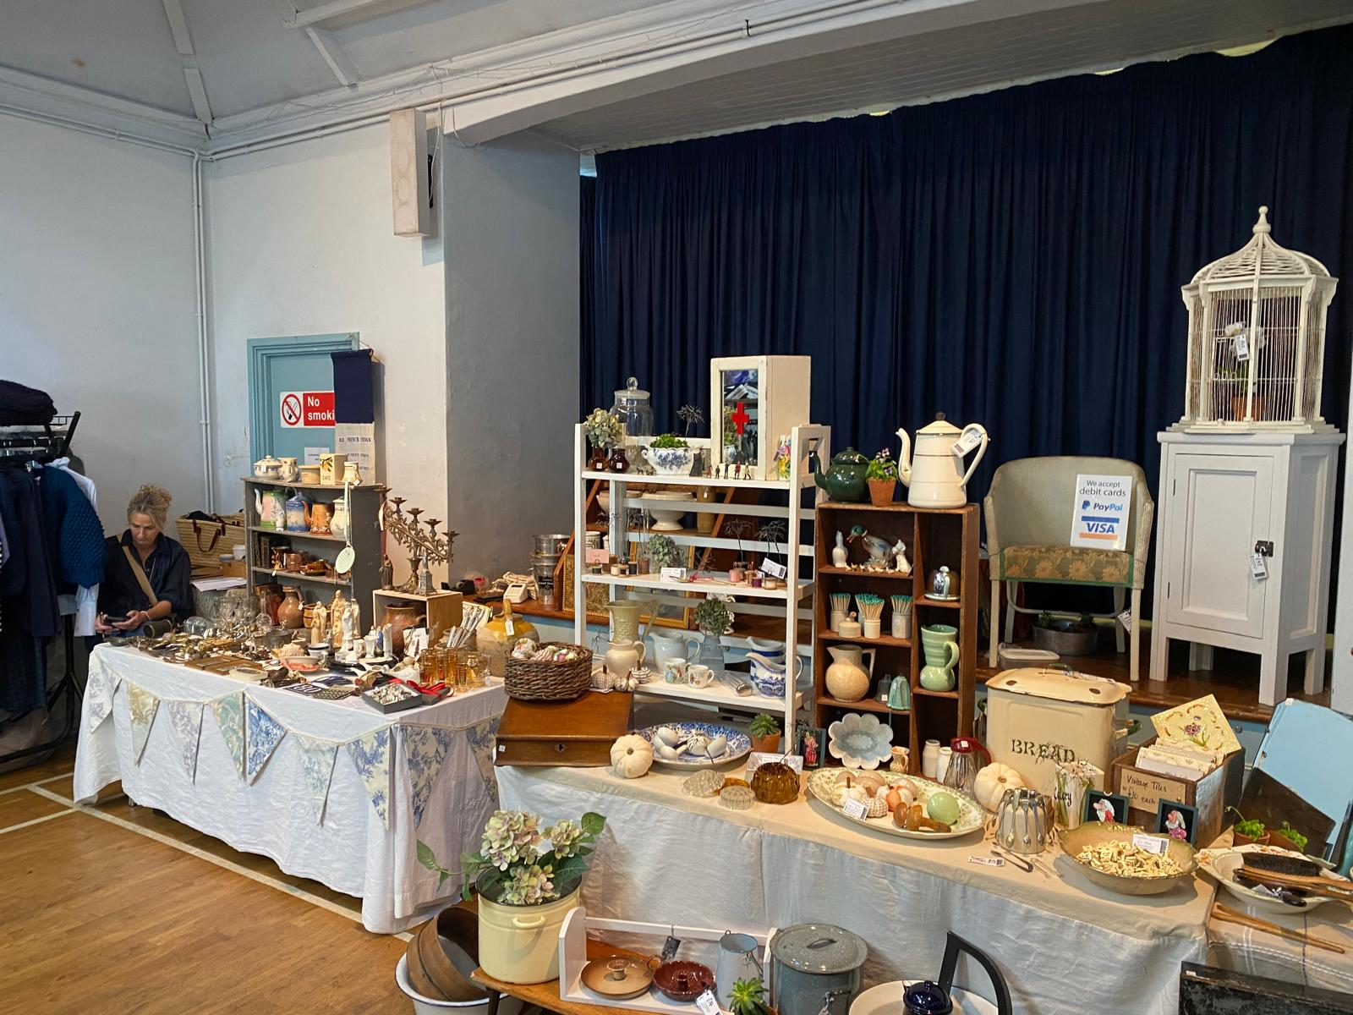
Events at the Arbuthnot Hall

Slide 22
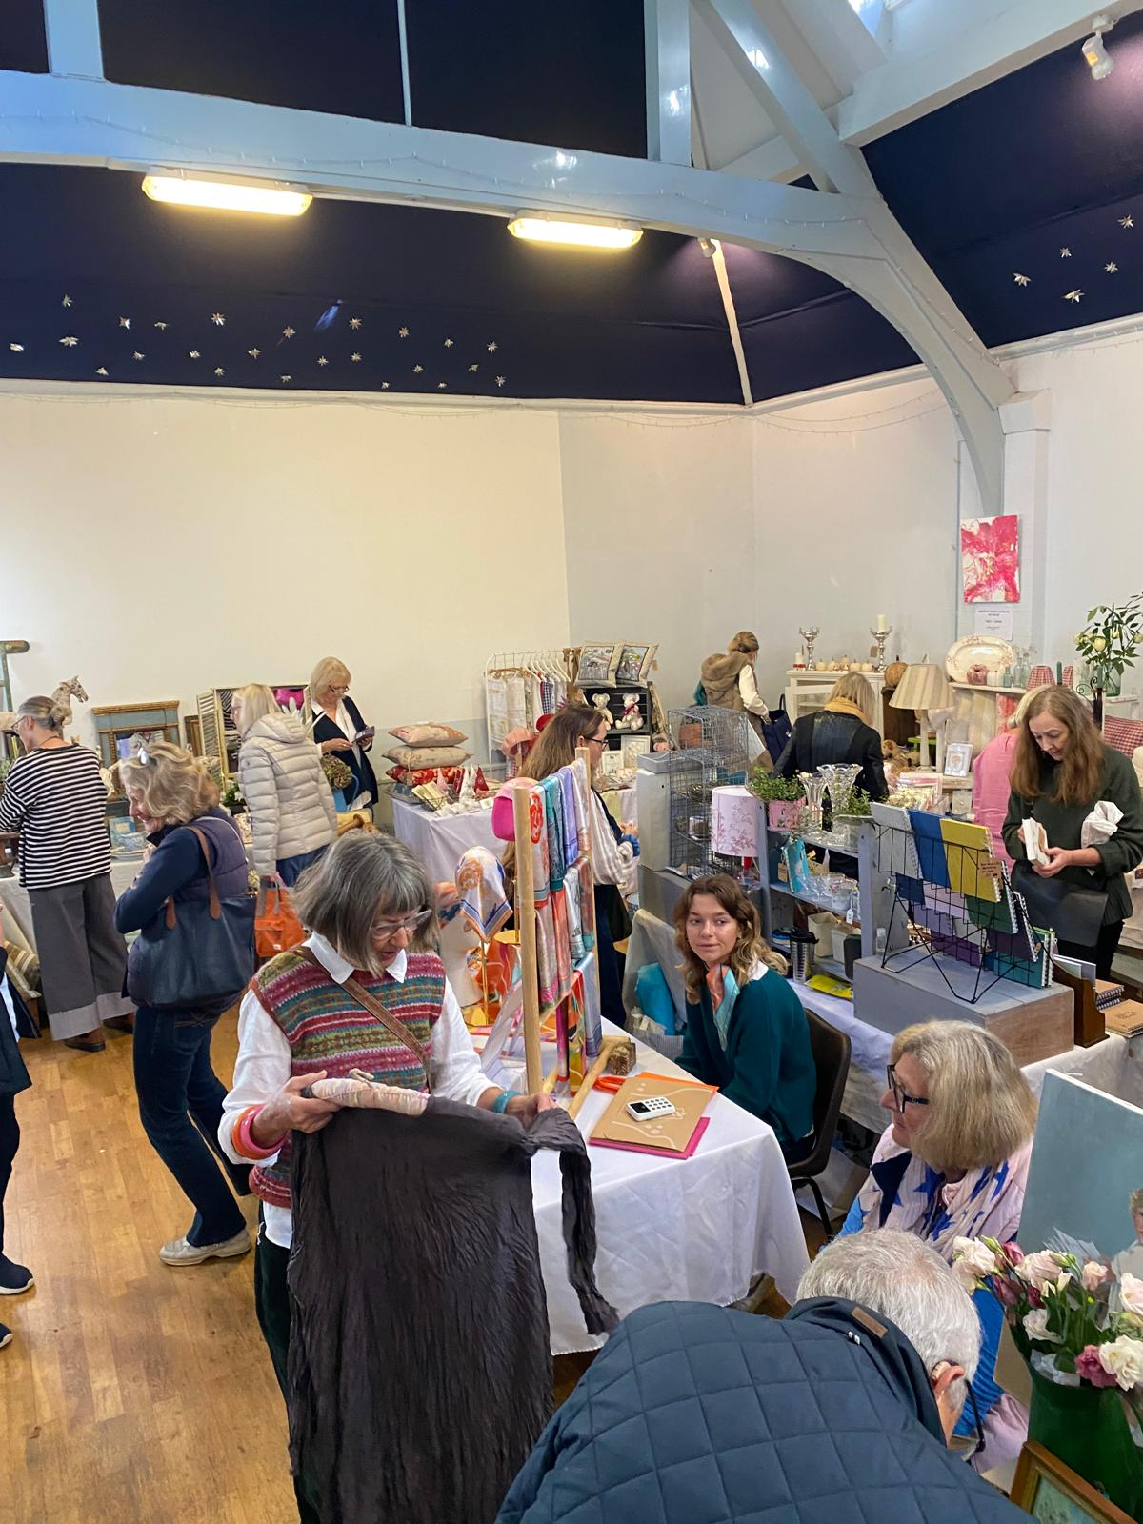
Events at the Arbuthnot Hall

Slide 23
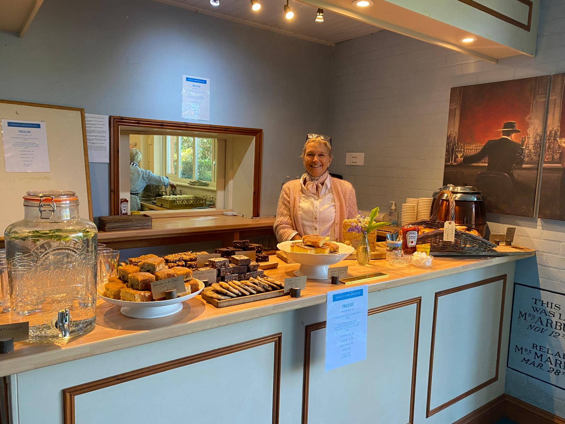
Events at the Arbuthnot Hall

Slide 24
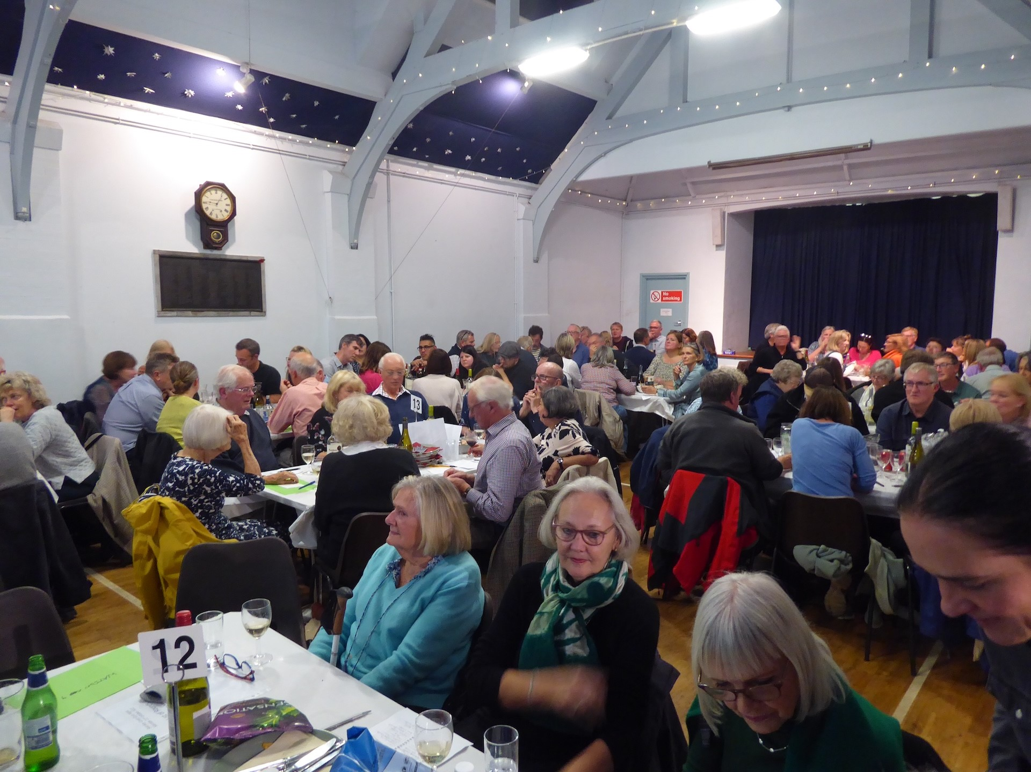
Events at the Arbuthnot Hall

Slide 25
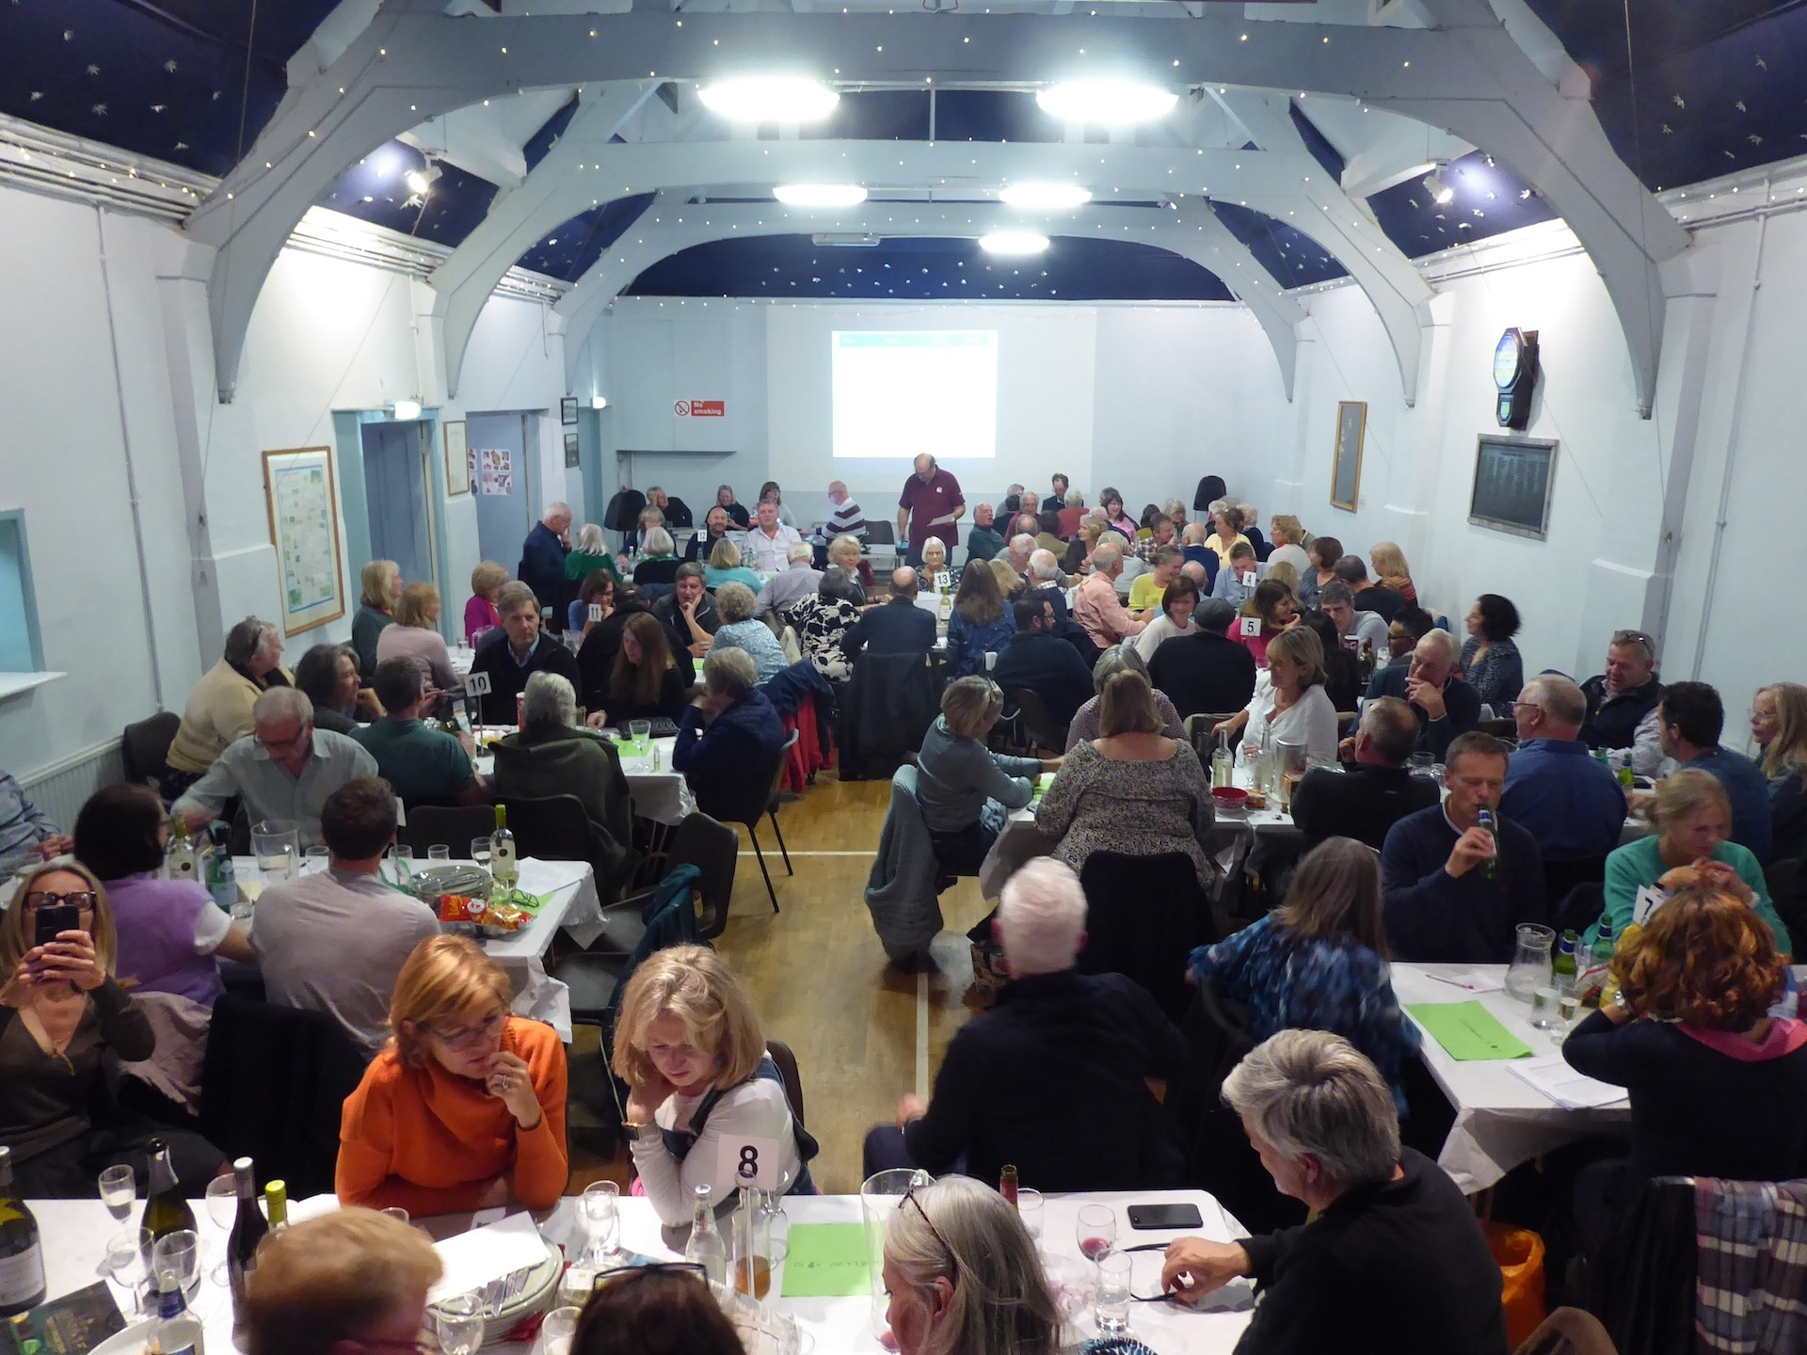
Events at the Arbuthnot Hall

Slide 26
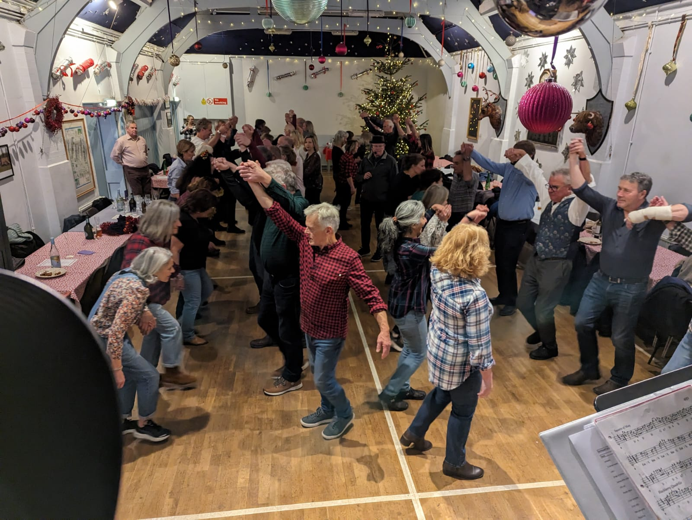
Events at the Arbuthnot Hall

Slide 27
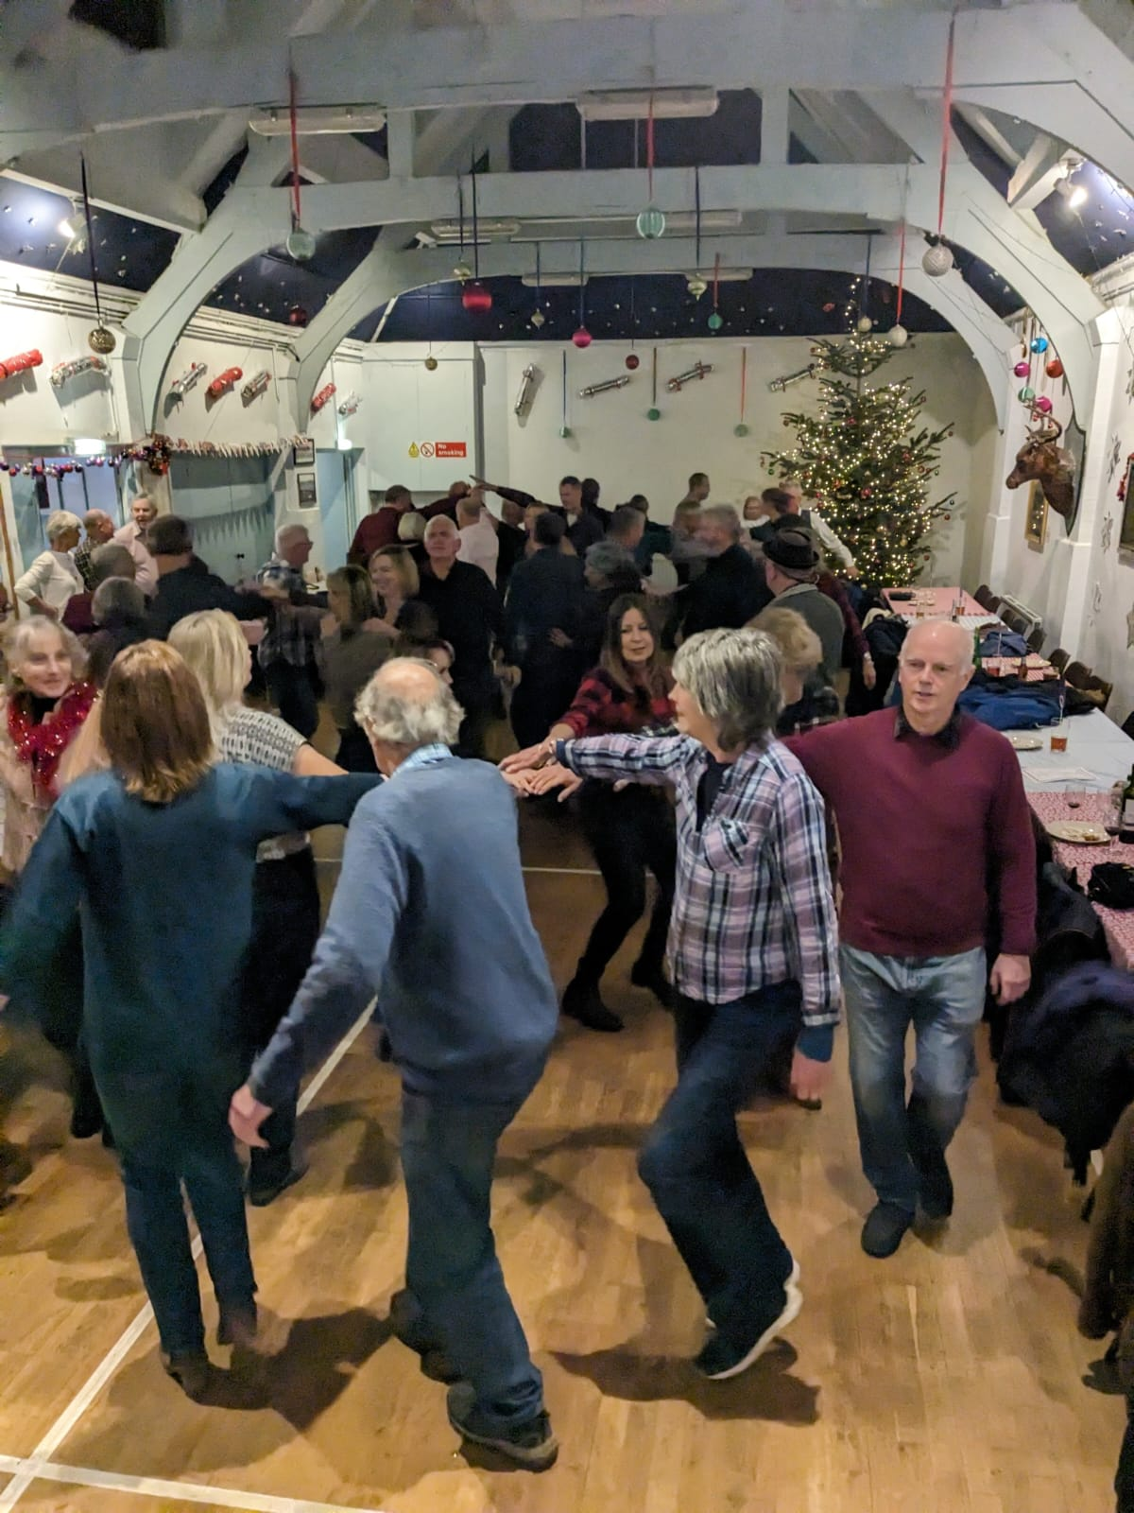
Events at the Arbuthnot Hall

Slide 28
Looking Ahead
Arbuthnot Tennis Cup
Pickleball continues plus Junior Sessions
Autumn Brocante
Quiz Night
Film Season starting in October
New – Bingo Night
New – Strictly comes to Shamley Green
New – Basket Weaving Workshops
Christmas ‘Light up the Green’ and Carol Singing
See: www.arbuthnothall.org for details.

Slide 29
Fundraising and FOAH
Report by Jim Drummond

Slide 30
Hall Operations
Report by Jon Watson

Slide 31
Governance
Report by Fiona Cameron

Slide 32
Any Other Business/ Questions
Thank you!

